Slide 1
FINAL YEAR PROJECT
SEMESTER JUNE 2025 (202509)
FYP BRIEFING
PREPARED BY
FOCS FYP TEAM

Slide 2
BRIEFING POINTS
01
FYP
An introduction
02
FYP Process Flow
What should I do as an FYP student?
03
Responsibilities
Supervisor vs Supervisee
04
FYP Project Requirements
What type of project can I do in FYP?
05
Important Dates
Please don’t forget these dates!
06
Communication Channel
Where can I get more information?

Slide 3
Introduction
What is FYP?

Slide 4

What is FYP?
Final Year Project (FYP)
compulsory for all final year students.
one of the requirements for graduation
Solving a real-world problem by implementing all the theories and skills gathered from Year 1 to Year 3
Showcasing the skills and talents for future employer’s assessment

Slide 5

FYP Structure
FYP / PROJECT 1
FYP report – Chapter 1 – 4
Initial finding – prototype/mockup
PHASE 1
PHASE 3
PHASE 2
PROPOSAL DEVELOPMENT
FYP / FYP 2
Idea & proposal development
Proposal moderation
Full project development & demonstration
FYP report : Chapter 5 – 7
FYP2 moderation
Final submission

Slide 6
Category of Project
DEVELOPMENT TRACK
System, web-application, mobile application, robotic, IOT, security app, smart app, etc
OTHER THAN FOR GRADING,
WHAT OTHER ADDED VALUES?
AIM
Submit for competition – internal/external
Convert to research paper publication
Ready for commercialization / industry funding for development
RESEARCH TRACK
Undergraduate level research – comparison / implementation / study of techniques, algorithm, approach, etc
Focus on :
Literature review
Research design / methodologies
Analysis & discussion
PROTOTYPE is compulsory

Slide 7
Special Category
INDUSTRY PROJECTS1
Collaborate with CBIEV – commercialization and industry relationship division in TARUMT
CBIEV will find industry clients and assign to supervisor
Students can request permission from supervisor to join the project
Students will be working with industry clients
Project can be short-term or long-term.
It will be very challenging but provide a good experience to students

Slide 8
Grading
GRADING COMPONENTS
Supervisor – Proposal, Project 1 Report, Project 2 Report, Product
Moderator – Proposal, Project 2 Report, Product
Refer to the rubric in GC

Slide 9
Process Flow
What to do?

Slide 10
What to Do?
Long Sem : 202505
Short Sem : 202509
Long Sem : 202601
Phase 1 : Proposal
Phase 2 : FYP 1
Phase 3 : FYP 2
Meet supervisor and discuss possible idea
Prepare FYP report - Chapter 1 to 4 ONLY
Full development activities
For group/pairing – must have CLEAR SEPARATION between each member
Initial finding for research
Prepare FYP report :
Add Chapter 5 to 7
Prepare the proposal
Mockup for development
Presentation with moderator
Submit Form 1 – Form 3
Final submission

Slide 11
What To Submit?
Phase 3 : FYP 2
Complete, correct & executable app/system
FYP 2 report
FYP 1 +
Chapter 5 : Development & Testing
Chapter 6 : Summary
Poster A1 size
Demo video
Abstract, keyword list
Phase 2 : FYP 1
FYP report
Chapter 1 : Introduction
Chapter 2 : Literature Review
Chapter 3 : Methodology & Requirement Analysis
Chapter 4 : Design
For research & game development : refer to your supervisor for details of chapters
Phase 1 : Proposal
Form 1 : Student Details
Form 2 : Proposal
Form 3 : Proposal Moderation
ALL SUBMISSION MUST BE INDIVIDUAL WORKS
Even for group, your submission must be individual
Do not copy your groupmate’s works

Slide 12
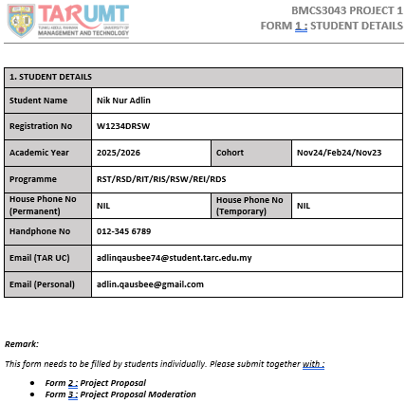
Example : Form 1

Slide 13
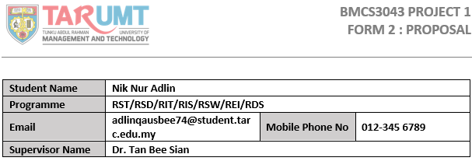
Example : Form 2
- Including other required details in the Form 2

Slide 14
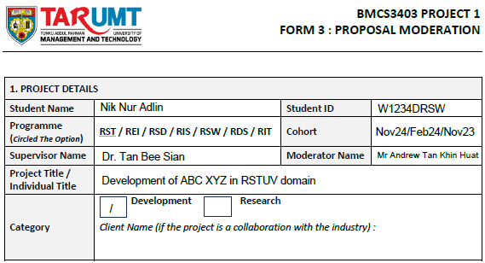
Example : Form 3

Slide 15
RESPONSIBILITIES
Supervisor vs Supervisee

Slide 16
Supervisor VS Supervisee
Give direction & guideline on flow
rojects, requirements
Find a •Find a supervisor
•Meet supervisor MINIMUM 6 TIMES
Advise, guide and revise the cont•Advise, guide and revise the content for each chapters of the report
chapters of the report
-
-
Follow the given timeline
•Moral support
support
Develop all the deliverables
Technical support (•Technical support (minimum)
)
Committed to the project

Slide 17
Lessons Learnt
FYP1 is not just a subject
Commitment
Dedication
Self-learning
Time management
REMEMBER !
Supervisor is not responsible for any technical assistance – coding
Excuses are not acceptable
I haven’t learnt this language
I don’t know how to use this
I spent a lot of moneys on this
I this…
I that…
Focus for 2 semesters
NOT 1 WEEK BEFORE SUBMISSION
Be proud of your works – showcasing your talents
FYP mark the beginning of student’s transition from university to real working world

Slide 18
FYP REQUIREMENTS
What need to be fulfilled?

Slide 19
Project = Study Domain!
RSD
software, system , information system, network, information management
RIT
web development, cloud application, mobile app
RIS
Information security, cybersecurity, network security, OS security
REI
business information system, business process and workflow, automation, ERP, DSS, e-commerce
RST
interactive software, computer games, edugames, VR, AR, computer animation, game design
RSW
can develop anything
MUST include process – model, analysis, design, testing
RDS
data science, visualization, ML, data analytics, data engineering,

Slide 20
Compulsory For All
Minimum Meeting
In all phases – MINIMUM 6 MEETINGS with supervisor
Your supervisor is the main reference point for FYP
Research or Development
Must have a working app/system
For research – a prototype to demonstrate research result
Must Include UI
All project must include UI
E.g. IOT 🡪 show data received and sent on console
Module Separation
For group – clear separation of module between team
NO Plagiarism
Acceptable Turnitin : < 24%
Declaration on the usage of AI as per requested by supervisor

Slide 21

AVOID THESE….
I want to do ..
My project is …
Chill lah…
I’m doing research …
Tickecting ….
Too small – similar to a coursework
I pay $500 for a complete FYP
I write papers only
Booking …
Too big – I want to develop nuclear missile system
Hey GPT, give me full code for…
I don’t want to code
Ordering …
Hello senior…
Restaurant ...
Delivery …

Slide 22
DATE & SUBMISSION
Lock the Date!

Slide 23
Phase 1 : Proposal (Sem 202505)
Approach SPV
Week 2 to 3
**Auto assign : Week 5
Idea Development & Proposal Writing
Week 2 to 9
Phase 1 Submission
Form 1, 2 & 3
Week 10, Friday
Proposal Moderation
Week 11
Phase 2 : FYP 1 (Sem 202509)
Report Writing
Chapter 1 – 4
Week 1 to 5
Final Report Submission
Week 6, Friday
FYP1 Marking
Week 7
Project Development
Start ASAP in Phase 2
Phase 3 : FYP 2 (Sem 202601)
Project Development
Week 1 to 8
Report Writing
Week 1 to 8
Final Submission (System, Report, Poster, Video, etc)
Week 10
FYP2 Moderation & Marking
Week 10

Slide 24
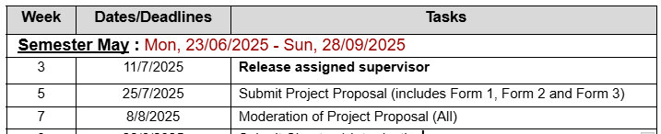
Phase 1 : Proposal (Sem 202505)

Slide 25
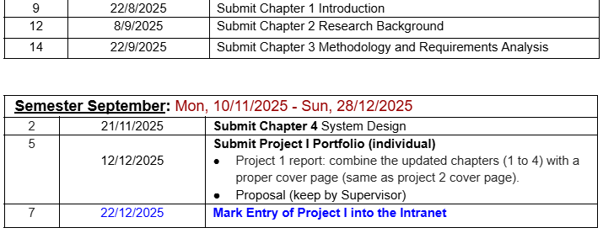
Phase 2 : FYP1 (Sem 202509)
Project 1/ FYP1 in 202501

Slide 26
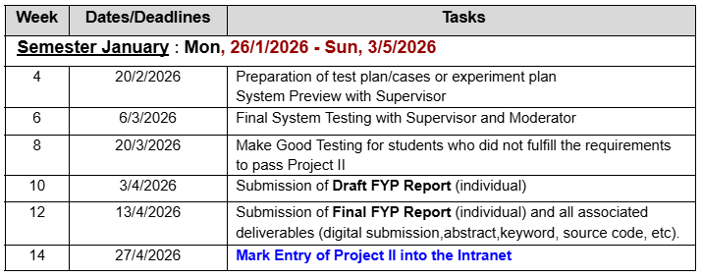
Phase 3 : FYP2 (Sem 202601)

Slide 27
Potential Supervisor 202505
https://focs.tarc.edu.my/people_1/faculty-staff

Slide 28
NOTE :
Submission date and other dateline is subject to change without prior notice
Always check latest announcement or update in Google Classroom
For comments and guidelines, send your report/product to your supervisor in stages. Don’t wait last minute

Slide 29
COMMUNICATION
Who to contact?

Slide 30
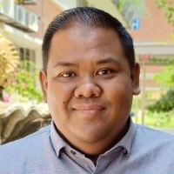
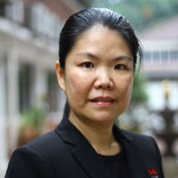
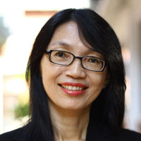
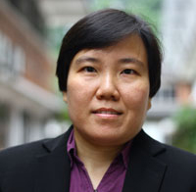

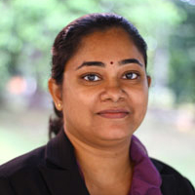
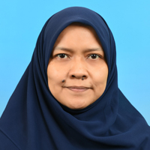
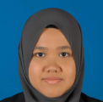
FOCS FYP TEAM
Mohd Ridzuan Ahmad
Chin Chai Lim
Gan Lay Kee
Yeoh Kar Peng
mohdridzuana@tarc.edu.my
clchin@tarc.edu.my
ganlk@tarc.edu.my
yeohkp@tarc.edu.my
Bavani Raja Pandian
Anurehka Magheswaran
Safinaz Mustapha
Nik Nur Adlin
bavanirp@tarc.edu.my
anurehkam@tarc.edu.my
safinaz@tarc.edu.my
niknuradlin@tarc.edu.my

Slide 31

7b34dtak
Display
202505 FYP HUB
CODE : 7b34dtak

Slide 32
THANK YOU
& GOOD LUCK

